Slide 1
Smart Traffic Vendor Project
Yashaswi Ranga Sivaraju
Arizona State University
Robotics and Autonomous Systems

Slide 2
AGENDA
Introduction
Estimated Schedule
Updates & Current Stage
Information Gathered
Challenges
Learnings and Contributions
Sources

Slide 3

INTRODUCTION
Introduction | Estimated Schedule | Updates and Current Stage | Information Gathered | Challenges | Learnings and Contribution | Sources
About the Project
Publishing a White Paper
Comparing the Hardware, Software, Costs, efficiency …
Vendors adhering to FDOT rules
Target Companies :
NoTraffic
Miovision
RythmEngineering
Iteris
Wavetronics

Slide 4

Estimated Schedule
Introduction | Estimated Schedule | Updates and Current Stage | Information Gathered | Challenges | Learnings and Contribution | Sources
25th Nov 2022
1st Dec 2022
30th Dec 2022
Conduct studies for real-world
performance evaluation
Scientific Paper Drafting
Final presentation to investors and final report submission

Slide 5


Updates and Current Stage
Introduction | Estimated Schedule | Updates and Current Stage | Information Gathered | Challenges | Learnings and Contribution | Sources
Initially, we focused on contacting vendors and obtaining quotes from them.
Furthermore, the policies with which the vendors must comply were investigated.
The project has been delayed due to issues with partnership between COX and ASU collaboratory.
Hence, I started researching about the vendors
Thus, I chose NoTaffic and Miovision

Slide 6
Information Gathered
Introduction | Estimated Schedule | Updates and Current Stage | Information Gathered | Challenges | Learnings and Contribution | Sources
Miovision:
No Traffic:
Focuses on reducing emissions, road safety and congestion
Remotely manage and track your traffic network
Miovision Scouts :
Camera based data sensor
Has the option for Custom Classification
Optimizes Lights timing based on Smart Sensors in real time
End to end hardware and software solution
Data of road users is transferred to cloud for additional processing
Plans to implement – Road as a Service (RAAS)

Slide 7
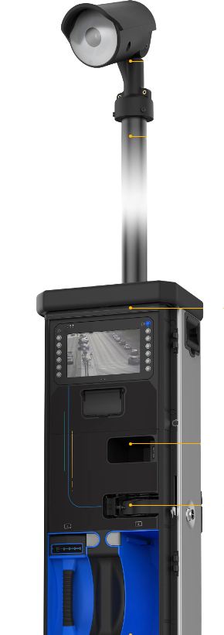
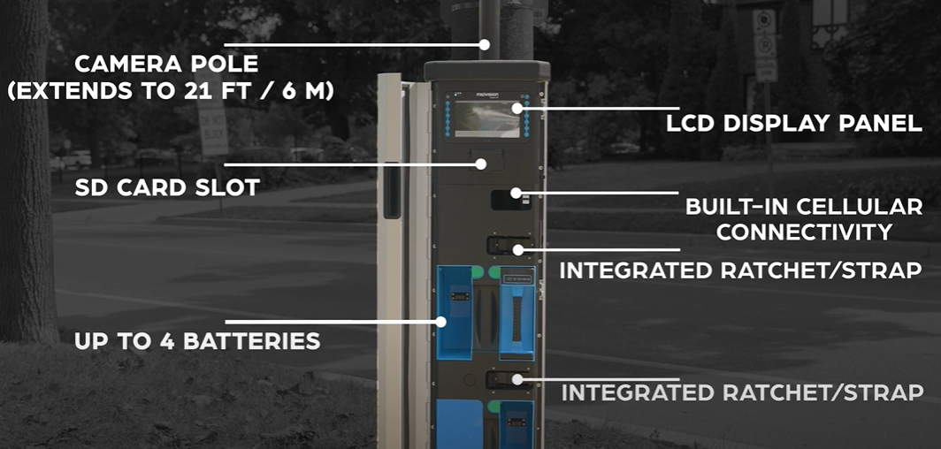
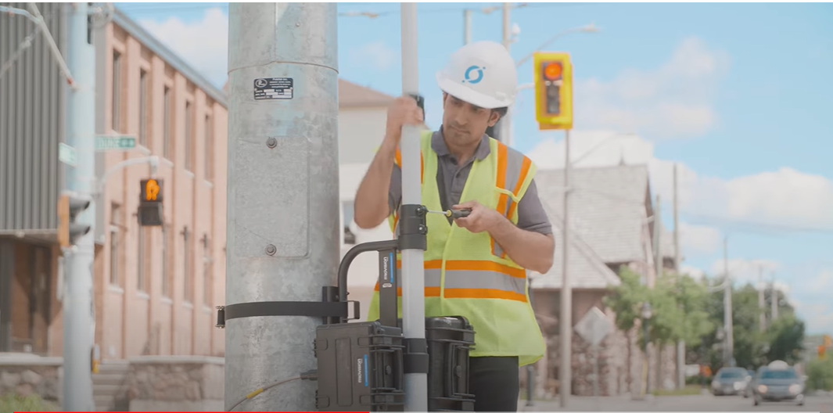
Miovision Scout
Introduction | Estimated Schedule | Updates and Current Stage | Information Gathered | Challenges | Learnings and Contribution | Sources

Slide 8
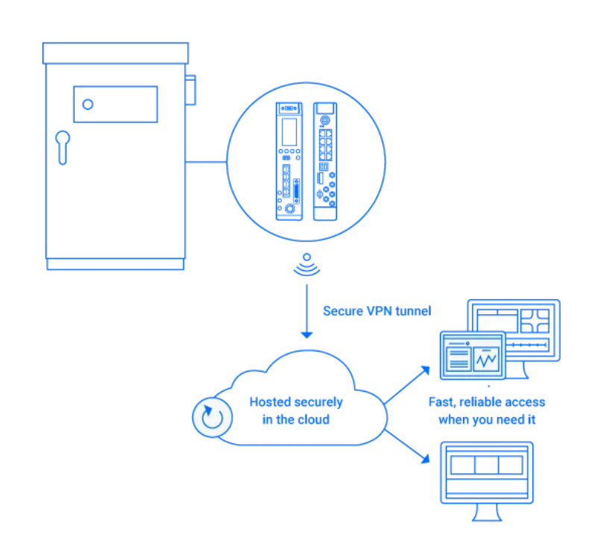
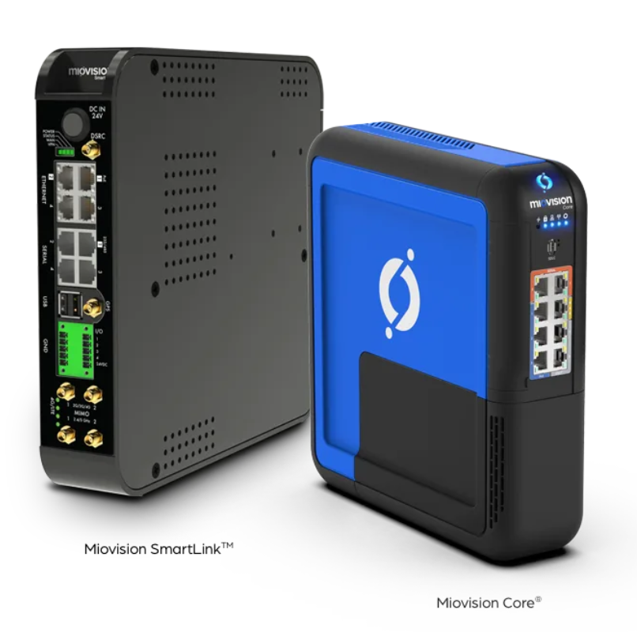
Miovision Smartlink
Introduction | Estimated Schedule | Updates and Current Stage | Information Gathered | Challenges | Learnings and Contribution | Sources

Slide 9
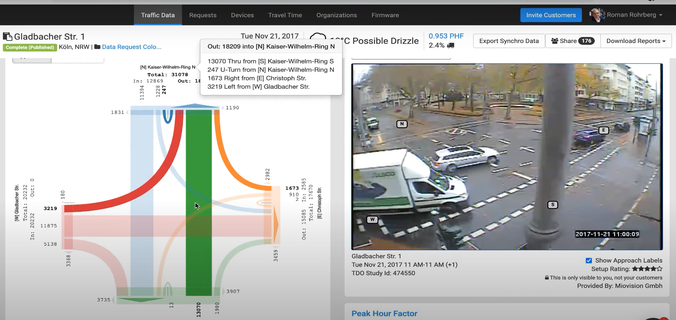
Introduction | Estimated Schedule | Updates and Current Stage | Information Gathered | Challenges | Learnings and Contribution | Sources

Slide 10
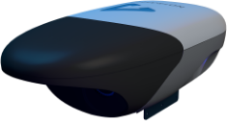
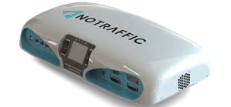
Notraffic
Introduction | Estimated Schedule | Updates and Current Stage | Information Gathered | Challenges | Learnings and Contribution | Sources
No Traffic Apps Engine
Plug & Play Sensors

Slide 11
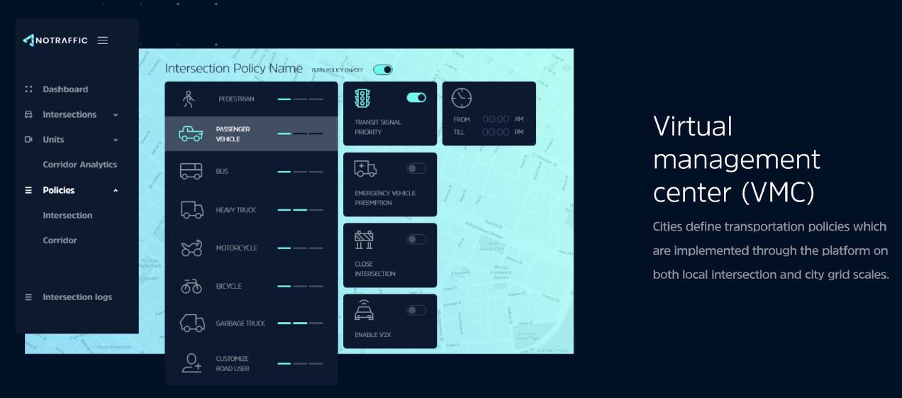
Introduction | Estimated Schedule | Updates and Current Stage | Information Gathered | Challenges | Learnings and Contribution | Sources

Slide 12
CHALLENGES
Introduction | Estimated Schedule | Updates and Current Stage | Information Gathered | Challenges | Learnings and Contribution | Sources
Vendor unavailability lack of proper communication from the vendors.
High cost of device procurement
High costs to use the services of the vendors

Slide 13

Introduction | Estimated Schedule | Updates and Current Stage | Information Gathered | Challenges | Learnings and Contribution | Sources
Capital Expenditure (CapEx):
Description | Qty | Price | Total
Miovision Scout Connect Video Collection Unit | 2 | $5,000.00 | $10,000.00
Scout Video Control Unit | 2 | Included | $0.00
Scout Polemount | 2 | Included | $0.00
Scout Connect Shipping & Handling | 2 | Included | $0.00
Shipping & Handling | 1 | $0.00 | $0.00
 |  | Subtotal (Net) | USD 10,000.00
 |  | Tax Total
 |  | Total | USD 10,000.00

Slide 14
Introduction | Estimated Schedule | Updates and Current Stage | Information Gathered | Challenges | Learnings and Contribution | Sources
Operational Expenditure (OpEx):
Description | Rate
Intersection Count (1 hour) | $21.00
Intersection Count with Premium class (1 hour) | $24.00
Light Goods Vehicle - Intersection Counts (1 Hour) | $2.00
Crosswalk Data (1 hour) | $2.00
Intersection Count 24+ Hour Study (1 hour) | $16.67
Intersection Count 24+ Hour Study with Premium Class (1 hour) | $18.00
Travel Time Report Generation (1-Hour) | $15.00
Travel Time Report Generation (24-Hour) | $12.50
Road Volume Count (1 lane-hour) | $2.00
Road Volume Count with Premium Class (1 lane-hour) | $3.00
Light Goods Vehicle - Road Volume Counts (1 lane-hour) | $0.25
Small Roundabout (1 hour) | $36.00

Slide 15
Introduction | Estimated Schedule | Updates and Current Stage | Information Gathered | Challenges | Learnings and Contribution | Sources
Operational Expenditure (OpEx) - Continuation:
Small Roundabout with Premium Class (1 hour) | $39.00
Large Roundabout (1 Hour) | $76.00
Large Roundabout with Premium Class (1 Hour) | $79.00
Light Goods Vehicle - Roundabout Counts (1 Hour) | $2.00
Pathway Volume (1 lane-hour) | $6.00
Junction Count (1 Hour) | $18.00
Intersection Right Turn On Red | $2.00
Rush Turnaround -48 Hours | $3.00
Rush Turnaround - 24 Hours | $7.00

Slide 16
Learnings and Contributions
Introduction | Estimated Schedule | Updates and Current Stage | Information Gathered | Challenges | Learnings and Contribution
Introduction | Estimated Schedule | Updates and Current Stage | Information Gathered | Challenges | Learnings and Contribution | Sources
I was able to contact FDOT officials about smart traffic and learn about the rules that vendors' devices must comply with to be installed in intersections and freeways.
I was able to gain insight into the future of smart traffic systems and how it is expected to evolve.
Getting a good understanding of the device's software and hardware requirements

Slide 17
Sources:
Introduction | Estimated Schedule | Updates and Current Stage | Information Gathered | Challenges | Learnings and Contribution | Sources
https://visme.co/blog/how-to-write-a-white-paper/
https://notraffic.tech/media-analysts/
https://www.ept.ca/2020/02/miovision-attracts-120-million-of-investor-funding/miovision-logo/
https://notraffic.tech/
https://miovision.com/

Slide 18
THANK YOU

Slide 19
Any Questions ?

Slide 20
